Slide 1
Stafford County Democratic Committee Monthly Meeting
13 April 2024

Slide 2
Agenda
Call to Order
Presentations/Introductions
  Welcome
  Vote Vets Video
  Elected Officials/VIPs/Guests
Administrative Business
  Approve Meeting Minutes
  Welcome/Vote-In New Members
Recurring Business
  Chair Report
  Treasurer’s Report
  Precinct Ops Report
  EXCOM Member Reports
  Sub-Committee Reports
Unfinished Business
  By-Law Amendment - Historian
New Business
Open Discussion
Adjourn

Slide 3


~presents ~
D-Day 40th Anniversary Speech
Point du Hoc
Rawhide

Slide 4
Presentations and Introductions
Elected Officials / VIPs / Guests

Slide 5
Administrative Business
Approval of Meeting Minutes

Slide 6
Administrative Business
Welcome and Vote-in New Members
Caroll Stacey
Katie Eveler
Nicholas Iroka-Ohia
Mary Becelia
Gary Holland
Emily Kuhl
Helen Herring
James Herring
Ruth Landry-Stone
Amy Lazerson
Zaher Moshtaq
Henry Thomasson
Paul Childers
Ron Pieper

Slide 7
Reports
  Chair Report
  Treasurer’s Report
  Precinct Ops Report
  EXCOM Member Reports
  Sub-Committee Reports

Slide 8
Chair Report
    CD7 Candidate Events
      14 April - 4PM United Faith Christian Ministry, 150 Sousa Drive, NAACP sponsored Forum – all candidates
      20 April - 1PM, Falls Run Community Center, 101 Bridgewater Circle, Falls Run Democratic Committee sponsored Meet & Greet **
      24 April - 7PM, Fredericksburg Convention Center, 2371 Carl D. Silver Pkwy, Stafford, Spotsylvania and Fredericksburg Democratic Committees & Fredericksburg Free Press sponsored forum
** FXBG Earth Day – Old Mill Park (11am – 4pm) & SDC Caucus Public Howell Branch Library (12pm – 3:30pm

Slide 9
Chair Report
2024 State Convention Milestones
Event | Purpose | Key Date(s)
Filing Deadline for SDC Caucus to elect Delegates to the 7th CD and State Conventions | Declare intent to be a delegate in order to appear on the SDC caucus ballot | 5:00PM Saturday, April 13th
SDC Caucus | Elect 34 Delegates and 6 Alternate Delegates to the 7th CD and State Conventions | April 20, 12:00PM – 3:30PM Howell Library Branch, Lyons Blvd.
Pre-file online for National Delegate Selected by the 7th CD | With 7th CD chair and State Party Chair | By 5:00 p.m. May 3.
7th Congressional District Convention | Elect 3 male and 3 female Delegates to the National Convention and 1 Democratic elector | May 18 at 12:00PM at James Monroe High School, Fredericksburg
Pre-file for National at Large Delegate or Democratic Elector or Democratic National Committee Member |  | 5:00PM May 30
2024 State Convention | Elect 13 Pledged Party Leaders and Elected Official Delegates, 21 At-Large Delegates, and 2 At-Large Alternates to the Democratic National Convention; elect 2 Democratic Electors; elect 5 Members to the Democratic National Committee | June 22 at 10:00AM at the Greater Richmond Convention Center
Virginia National Convention Delegation Meeting | Elect Chair & other officers | June 23
National Convention |  | August 19-22 at the United Center in Chicago.

Slide 10
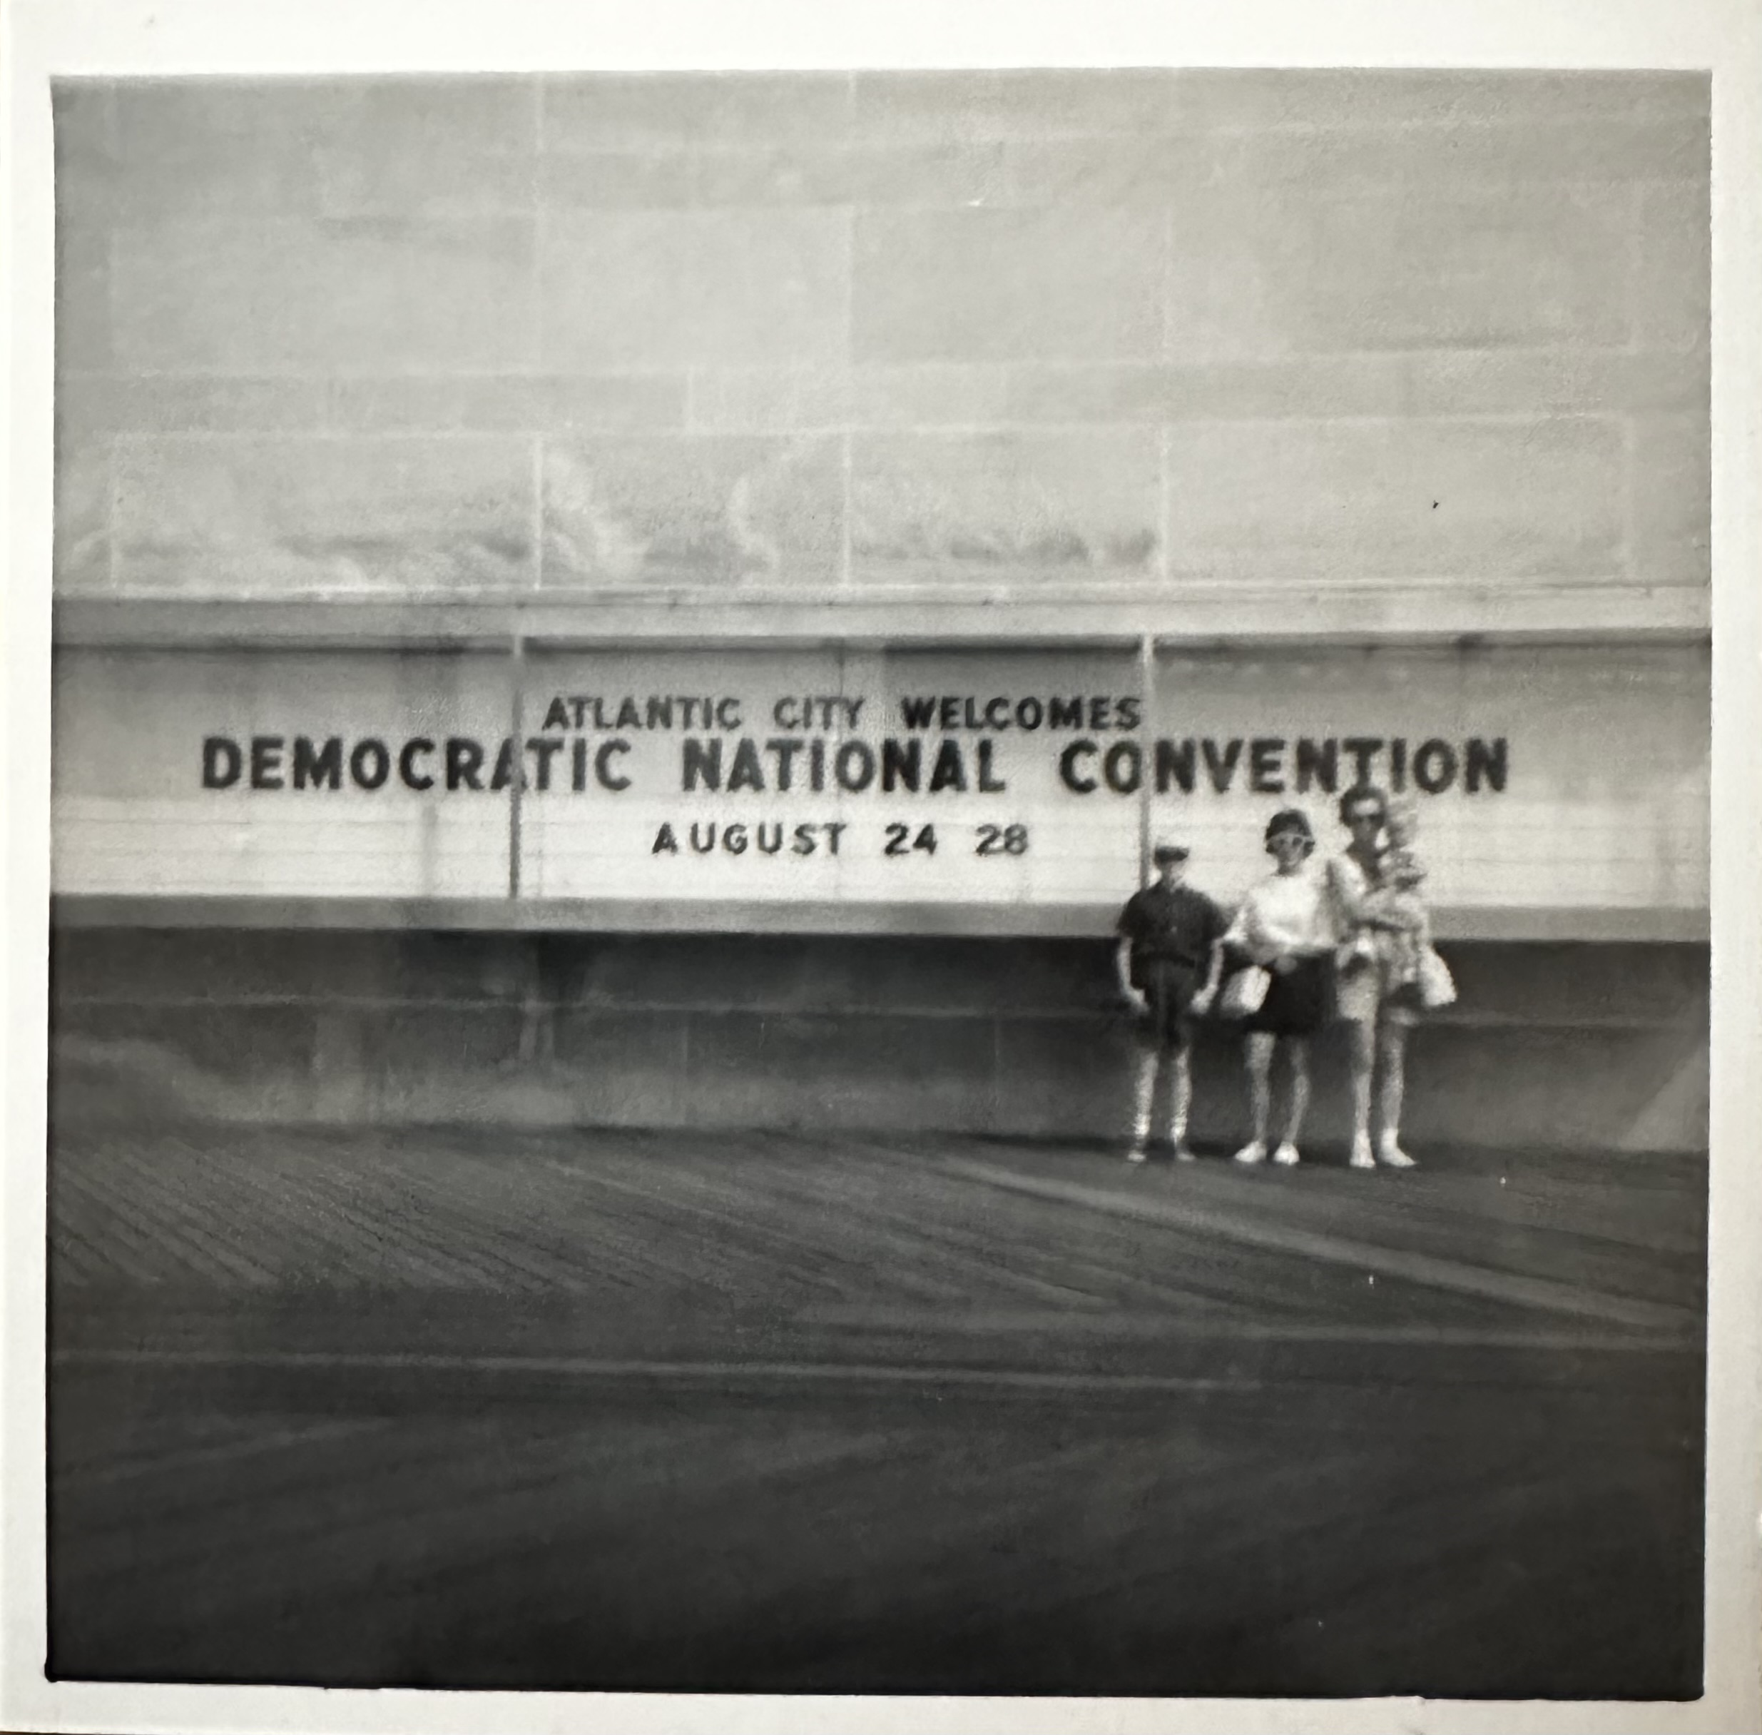
My first convention!

Slide 11
Chair Report
    Support Housing for Campaign Workers
      Interested people can volunteer to provide housing to a member of Tim Kaine's re-election campaign:
        Are you able to provide a room for a member of Team Kaine to live in through November?
        How many people currently live in your home?
        Please briefly describe the accommodation (is there a separate entrance, separate bathroom, separate living space, etc.)
        Do you have any pets?
        Have you ever provided supporter housing for organizers in past cycles?

Slide 12
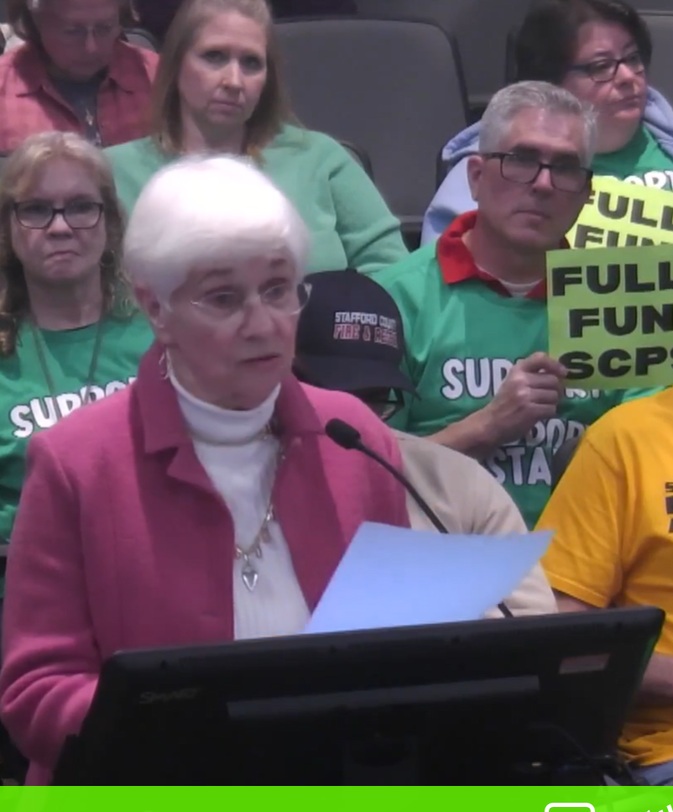
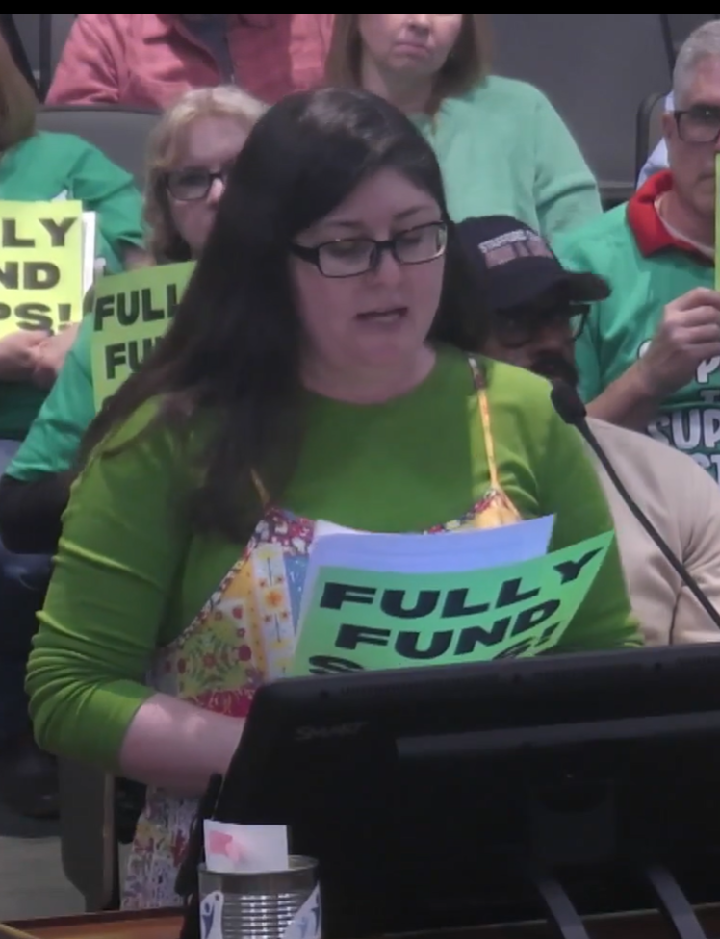
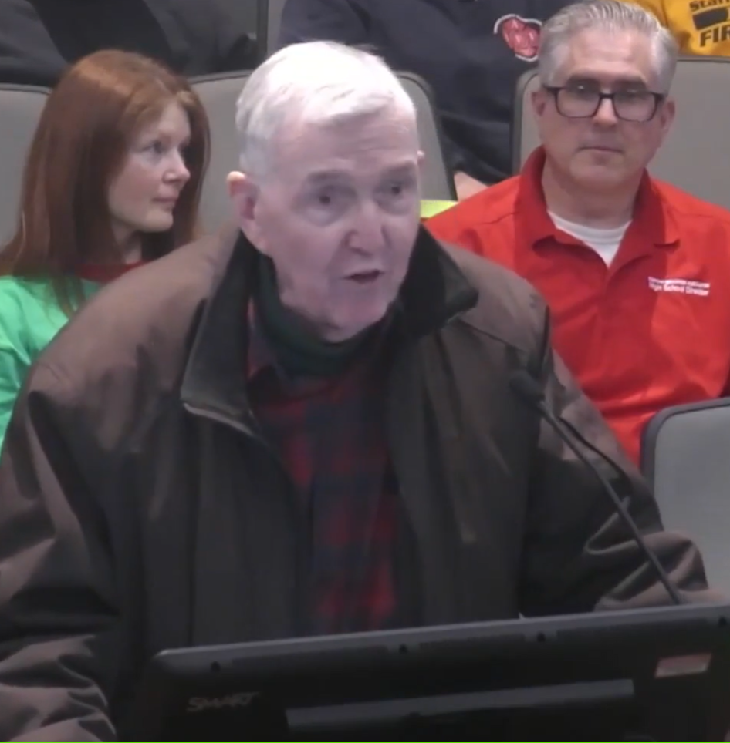
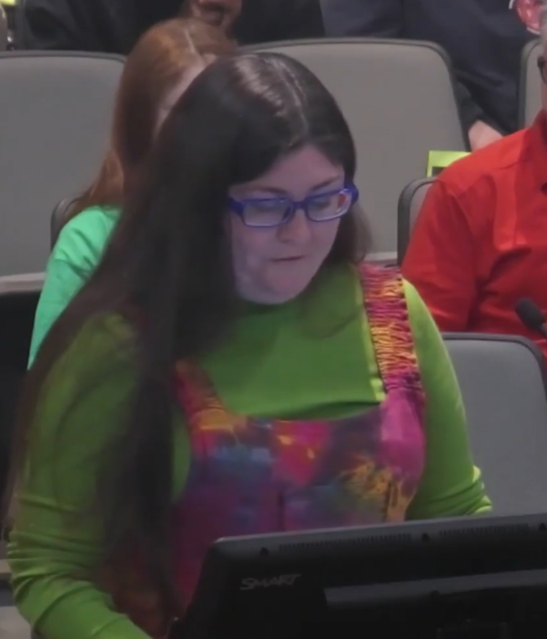
Chair Report
    SDC Speakers at Board of Supervisor Meetings

Slide 13
Reports
  Precinct Ops Report

Slide 14
Reports
  Precinct Ops Report

Slide 15
Reports
  Precinct Ops Report

Slide 16
Reports
  Precinct Ops Report

Slide 17
Reports
  Precinct Ops Report

Slide 18
Reports
  Precinct Ops Report

Slide 19
Reports
  Precinct Ops Report

Slide 20
Reports
  Precinct Ops Report

Slide 21
Reports
  EXCOM Member Reports

Slide 22
Subcommittee Appointments
Subcommittee | Chair | # of Volunteers
Finance | Dawn White | 4
Issues | Liza Warner & PJ Regan | 20
Candidate Search & Support | Howard Rudat (temporary)* | 7 **
Membership | Dick Roop | 8
Precinct Operations | Shannon Fingerholz | 10
Public Relations | Alane Callander | 4
Ways and Means | Caitlin Bennett | 4
Technology | Ryan Lehman | 4
Outreach & Visibility | Caitlin Goodale-Porter | 10
Bylaws | Tom Kimbrell | 2
* PJ and Alex Regan will co-chair after June primaries.
** Elected officials who are up for reelection in the next two-year cycle eliminated due to perceived conflict of interest
Bolded Names are dual-hatted EXCOM members.

Slide 23
Reports
  Sub-Committee Reports
    Covers previous 30 days and plans for next 90 days +

Slide 24
Bylaw Amendment
Purpose: Create an Historical Archive of SDC Activities
Structure: Individual/Subcommittee
Proposed Bylaw wording:
Archives/History Sub-Committee
The subcommittee shall ensure that the SDC's historical documents are maintained. All records should be digitized and available on the SDC Share Drive. This includes, but is not limited to, past and current records about major events, such as caucuses with their results, fundraisers, campaign-related events and meet-and-greets, as well as after-action reports and outlines of procedures followed. Media releases and articles published should be included, as should links to videos. A history of Officers and Subcommittee Chairs should be kept.

Slide 25
Open Discussion

Slide 26
Adjourn
See you May 11th

